Slide 1
Welcome
A program of Marianjoy Rehabilitation Hospital, now part of Northwestern Medicine
Webinar for Business The New Business Frontier: Disability Inclusion
We’ll be starting promptly at 10 am CST

Slide 2
Kathleen C. Yosko, RN, BSN, MS, MBA, PhD President, Marianjoy Rehabilitation Hospital
Kathleen Yosko has served as President and Chief Executive Officer of Marianjoy Rehabilitation Hospital and the Marianjoy Medical Group since 1998. In 2016, Ms. Yosko spearheaded the design and construction of a new technology center, The Tellabs Center for Neurorehabilitation and Neuroplasticity (TCNN), utilizing innovative diagnostic and treatment capabilities for adults and children experiencing neurologic impairment. Since her tenure a state-of-the-art replacement hospital opened in 2006, outpatient pavilion in 2007, the Marianjoy Assistive Technology Center (MARTI), Aquatic Therapy Center and Conference Center in 2014. In 2001 Ms. Yosko founded AbilityLinks along with a progressive board of directors. Her belief has always been that physical rehabilitation is not adequate if one cannot re-enter a lifestyle of their choosing after disability. AbilityLinks is a focal part of that re-entry, connecting people with disabilities with inclusive employers.
A program of Marianjoy Rehabilitation Hospital, now part of Northwestern Medicine

Slide 3
Scott Hoesman Webinar Moderator CEO and Founder, inquest
An accomplished and sought-after speaker, executive facilitator, author and senior organizational strategist, Scott is best known for his ability to implement full-scale, long-term people strategies across a wide spectrum of industries and geographies. Scott’s focus is on helping individuals, teams and organizations realize their full potential. He has deep subject matter expertise in disability and LGBT workplace inclusion initiatives. Scott is on the Executive Board of the Corporate Advisory Board for the USBLN, the Board of the Chicago Business Leadership Network (CBLN) and the AbilityLinks Steering Committee.
A program of Marianjoy Rehabilitation Hospital, now part of Northwestern Medicine

Slide 4
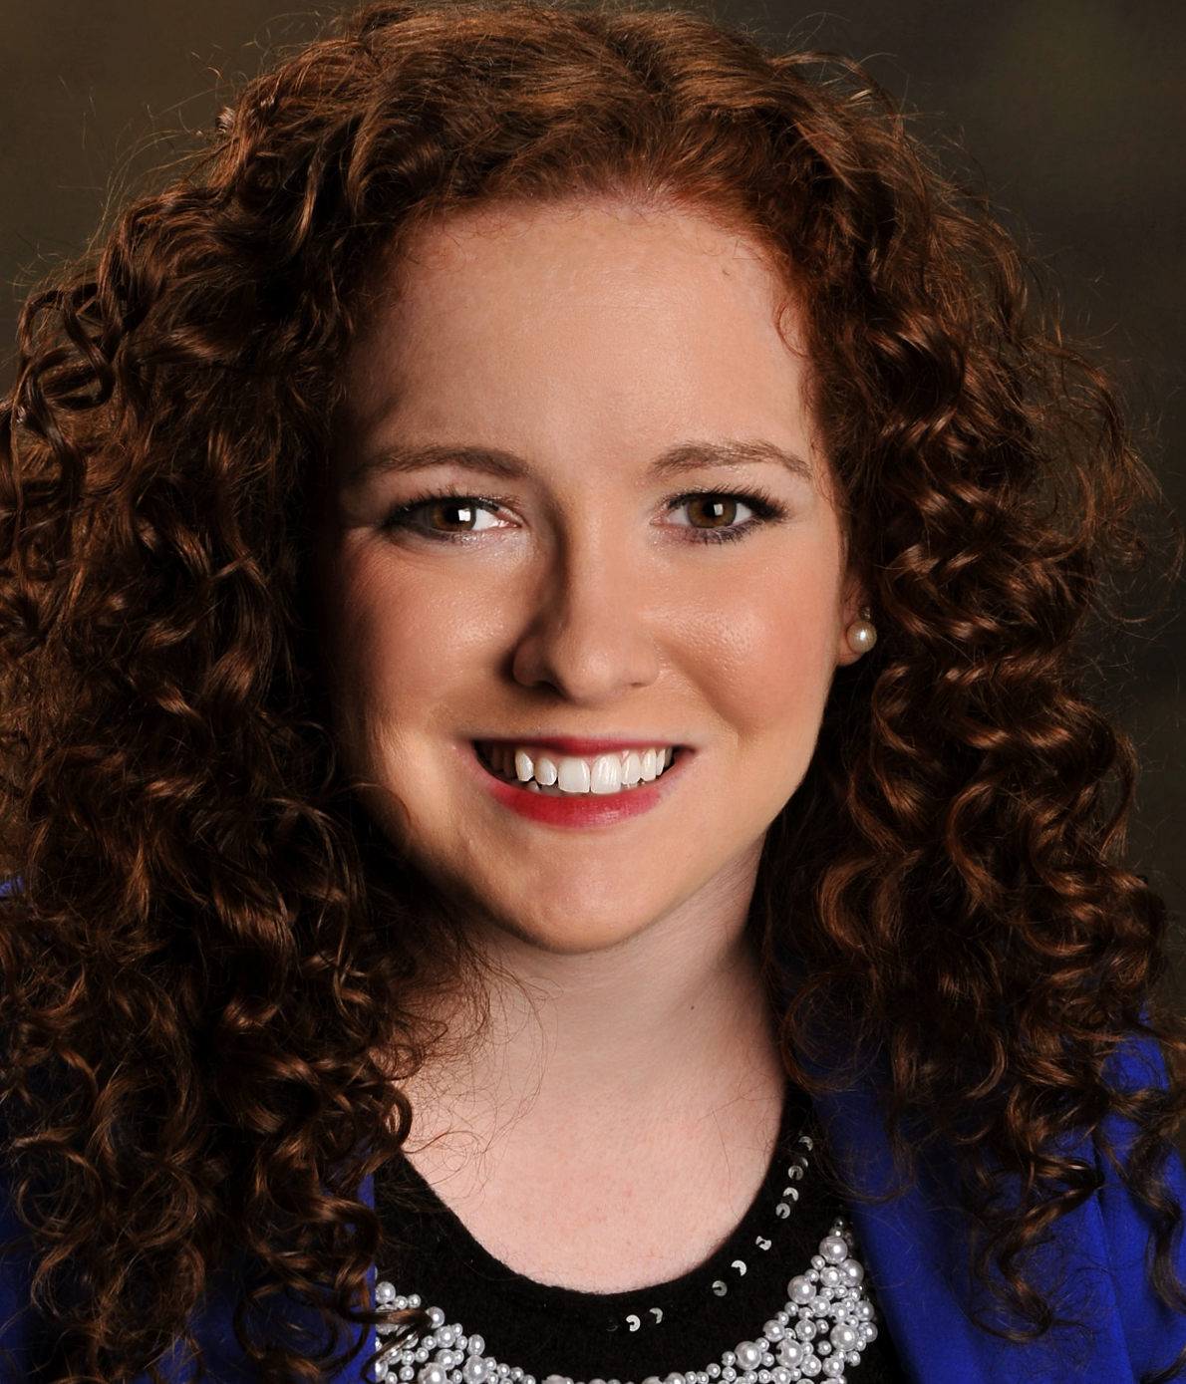
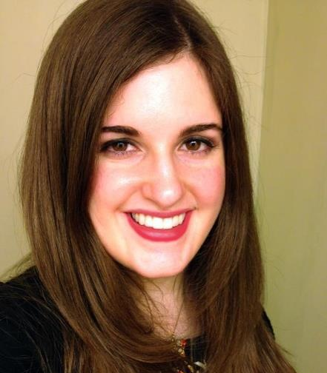
Panelists
Kierstin Miller
EA Engineering, Science and Technology Inc.
Shannon Webster
Exelon Corporation
Amanda Fowler
Northwestern Medicine
Bradley A. Anderson
U.S. Department of Labor Office of Federal Contract Compliance Programs – Midwest
A program of Marianjoy Rehabilitation Hospital, now part of Northwestern Medicine

Slide 5
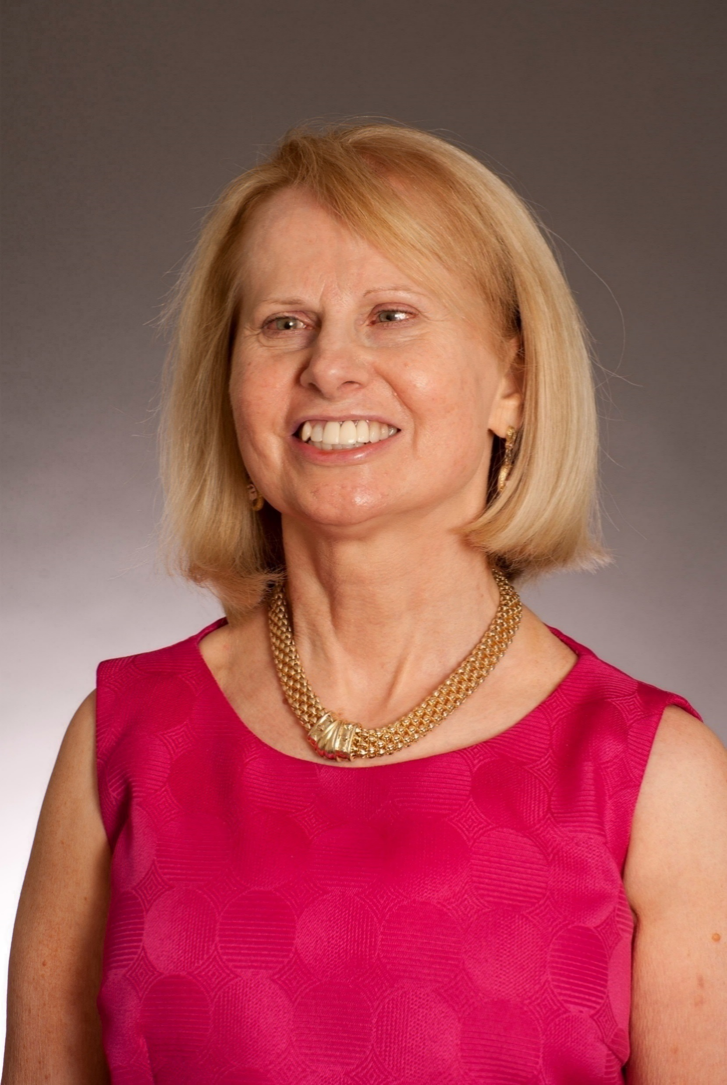
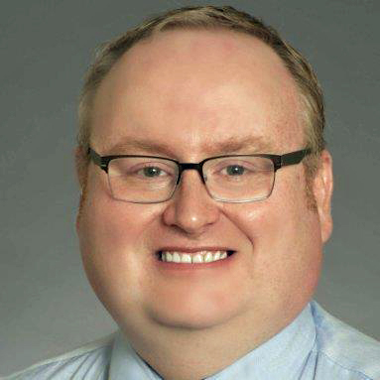
To Learn more about how AbilityLinks can become a resource for your company visit AbilityLinks.org
Ken Skord
AbilityLinks Program Director
Janice Duvall
AbilityLinks Information and Referral Counselor
Bill O’Connor
AbilityLinks Information and Referral Counselor
A program of Marianjoy Rehabilitation Hospital, now part of Northwestern Medicine

Slide 6
Thank You for Joining Us!
A program of Marianjoy Rehabilitation Hospital, now part of Northwestern Medicine
Webinar for Business The New Business Frontier: Disability Inclusion

